Slide 1






🥭Operation Mango: Scalable Discovery of Taint-Style Vulnerabilities in Binary Firmware Services
Wil Gibbs, Arvind S Raj, Jayakrishna Menon Vadayath, Hui Jun Tay, Justin Miller, Akshay Ajayan, Zion Leonahenahe Basque, Audrey Dutcher, Fangzhou Dong, Xavier Maso, Giovanni Vigna, Christopher Kruegel, Adam Doupé, Yan Shoshitaishvili, Ruoyu Wang
Notes:
Hi everyone, my name is Wil Gibbs. Thank you for coming to my talk about Operation Mango!
Before we get started, I just wanted to say that problems like these are difficult. And difficult problems require scalable solutions. So as you can see our author list also scaled to the usenix security approved 15.

Slide 2
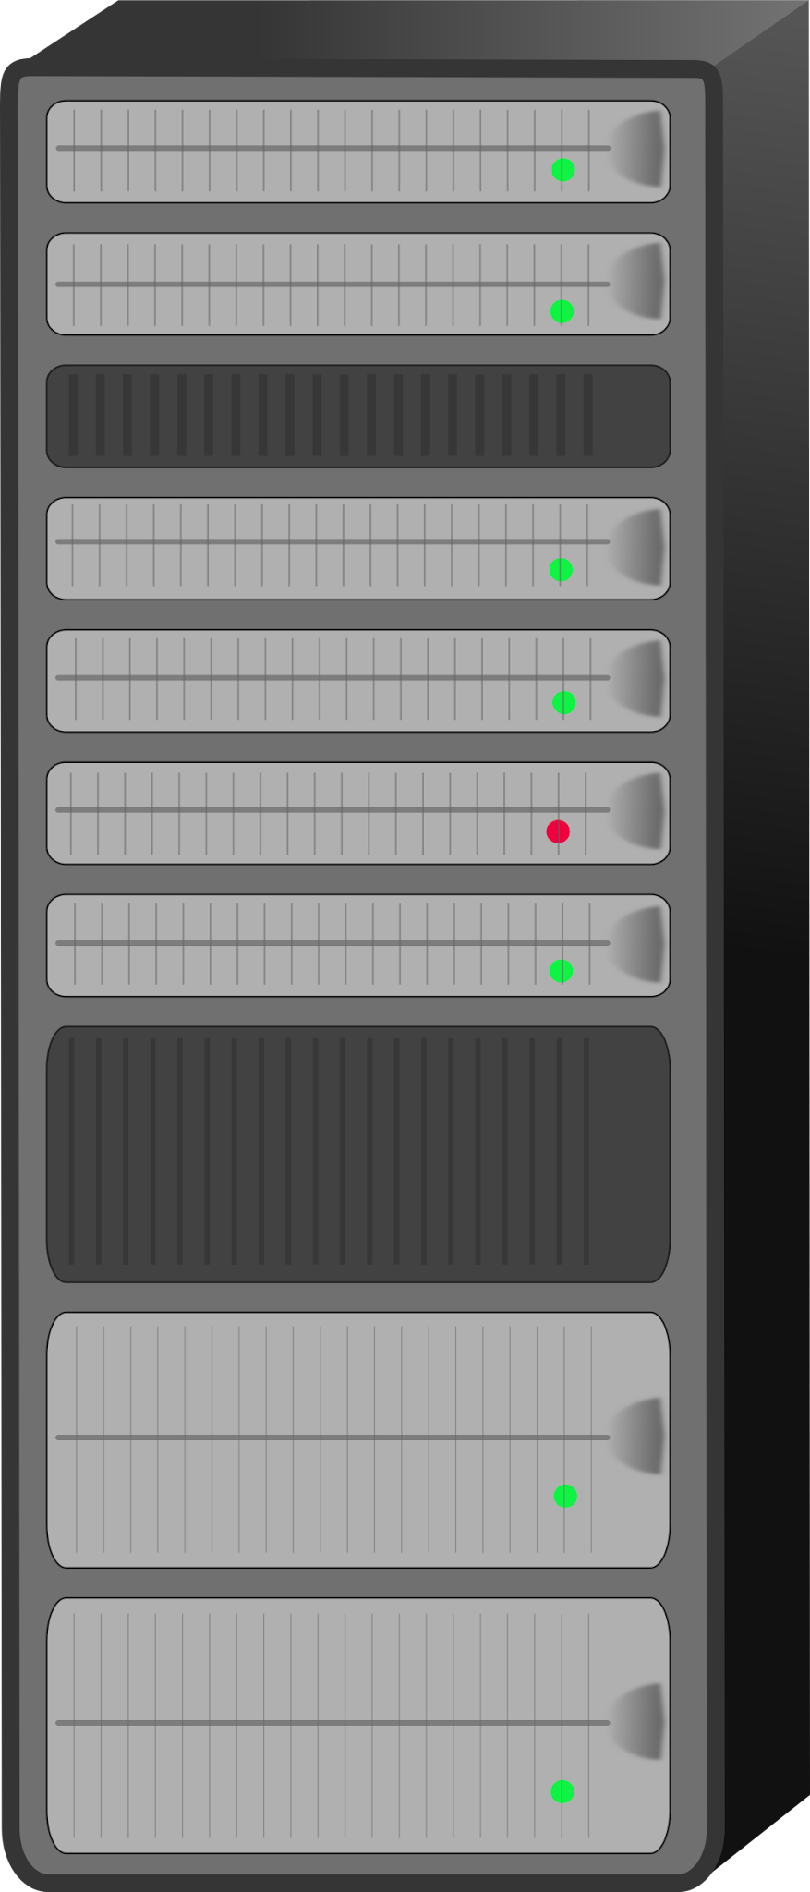



Firmware in Embedded Devices
Router
NAS
Camera
Notes:
Firmware lives in devices that you all use every day. Routers, NAS’s, Cameras. All of these devices are run on firmware.

Slide 3
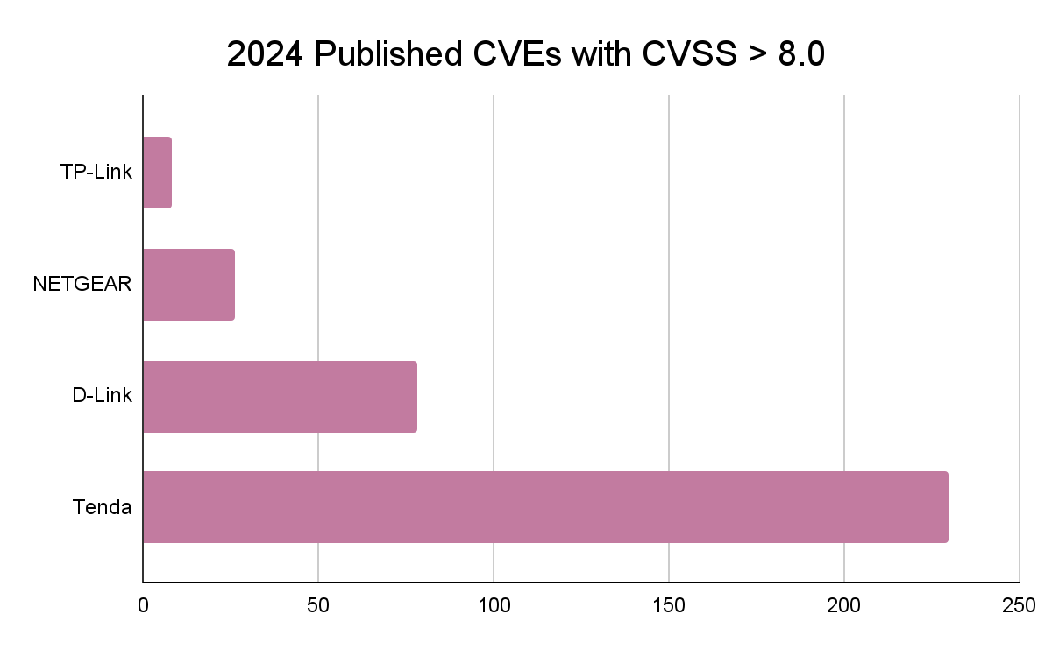
Recent IoT CVEs
Notes:
However, in 2024 alone more than 300 CVEs, with CVSS scores greater than 8, in just 4 major vendors have been published.

Slide 4


Binary Analysis is Necessary
✔
Notes:
However, auditing these devices is not straight forward. Source code is not generally available and physical devices are expensive and difficult to test at scale, so binary analysis is necessary to find these vulnerabilities faster and more efficiently.

Slide 5
Types of firmware
Notes:
But first we must understand how these devices operate. Firmware can be separated into two COMMON categories.

Slide 6

Blob-Based Firmware
Notes:
Blob-based firmware, which is just that. A single blob constructed of many disparate utilities or binaries stuck together into a single cohesive unit.

Slide 7

Linux-Based Firmware
Notes:
And Linux Based Firmware. These firmware run tiny linux distributions, such as alpine, and implement functionality as individual binaries.
We will direct our focus to linux-based firmware

Slide 8
Multi-Binary Dataflow
NVRAM: Non-Volatile Random Access Memory
httpd
void change_passcode(request) { passcode = get_http_param(request, "iserver_passcode"); nvram_set("iserver_remote_passcode", passcode); system("dlnad"); }
NVRAM
dlnad
void main() { passcode = nvram_get("iserver_remote_passcode"); sprintf(v11, "set_password %s", passcode); system(v11); }
NETGEAR R6400 Router
Notes:
You can’t analyze these firmware binaries independently, you need knowledge of how data flows between them in these multi-binary systems. One of the popular methods for multi-binary interactions is to use `nvram`.. Here, `httpd` sets a value into `nvram`, a key method in which binaries communicate, which is then retrieved in a second binary. In this case, the binary `dlnad` retrieves the value and does some operation.

Slide 9
Symbolic Execution
n₁
e₁
e₇
e₂
e₃
e₄
e₅
n₅
e₆
n₆
n₅ = e₁⋀((e₂⋀e₄)⋁(e₃⋀e₅))
n₆ = e₁⋀(∑n₅⋀(e₇⋁e₆))
Notes:
To handle this multi-binary interaction, prior work KARONTE used under-constrained symbolic execution-based taint analysis to find constraints on inputs and propagate them across the nvram boundary.

Slide 10

Symbolic Execution Does Not Scale
n₁
e₁
e₇
e₂
e₃
e₄
e₅
n₅
e₆
n₆
n₅ = e₁⋀((e₂⋀e₄)⋁(e₃⋀e₅))
n₆ = e₁⋀(∑n₅⋀(e₇⋁e₆))
Notes:
However, I’m sure some of you have used symbolic execution know from experience that symbolic execution does not scale.

Slide 11
Symbolic Execution Does Not Scale
n₁
e₁
e₇
wandetect
pptp
wlconf
e₂
e₃
wan.cgi
e₄
e₅
network.cgi
password.cgi
dlnad
ddns
n₅
httpd
e₆
n₆
n₅ = e₁⋀((e₂⋀e₄)⋁(e₃⋀e₅))
user_input
n₆ = e₁⋀(∑n₅⋀(e₇⋁e₆))
Notes:
So slow, in-fact, that we cannot process all of the input and communications that these binaries are doing.
To handle this, they needed to limit the scope of the analysis.

Slide 12
Border Binaries
n₁
e₁
e₇
wandetect
pptp
wlconf
e₂
e₃
wan.cgi
e₄
e₅
network.cgi
password.cgi
dlnad
ddns
n₅
httpd
e₆
n₆
n₅ = e₁⋀((e₂⋀e₄)⋁(e₃⋀e₅))
user_input
n₆ = e₁⋀(∑n₅⋀(e₇⋁e₆))
Notes:
They created the concept of Border Binaries. Binaries that receive input from external sources, parse said input, and propagate the information.
They then select a subset of these binaries and focus their analysis on them.

Slide 13
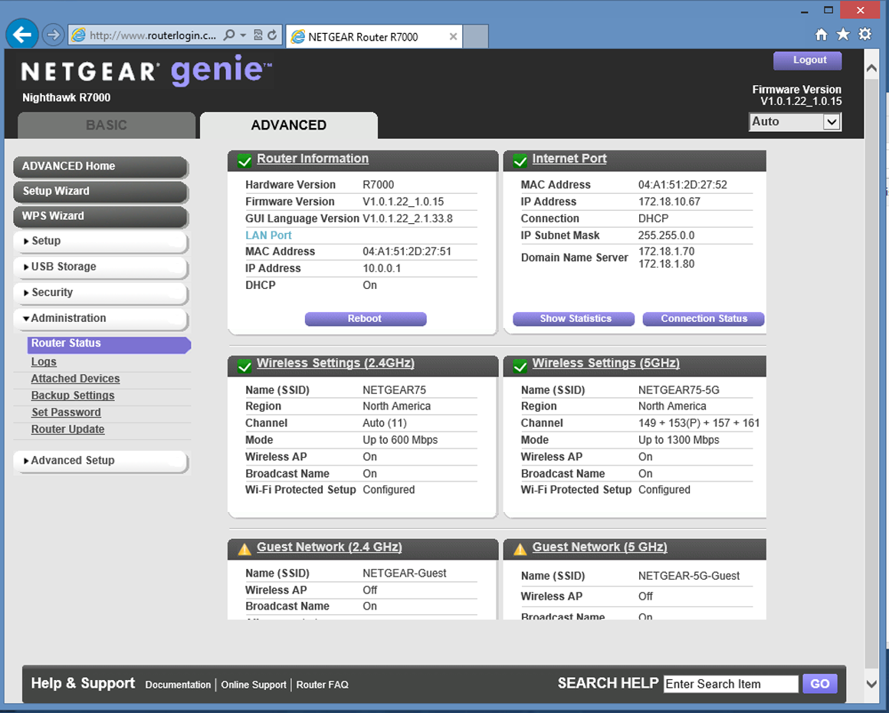
Firmware Dataflow
Frontend
Web Server
Backend Utilities
// Handle POST Request if (strcmp(request.type, "POST"))
{ if (strcmp(request.location,
"password_recovery.cgi")) { nvram_set("password”, request.params[0])
system("password_recovery.cgi") } ...
}
password_recovery.cgi
Notes:
SaTC, a follow up work, sped up the analysis and found many more bugs through narrowing the scope further. They identified a specific input-source, front-end interfaces like management panels, configuration UI’s, etc…

Slide 14
Operation Mango
wandetect
wlconf
pptp
wan.cgi
network.cgi
password.cgi
dlnad
ddns
httpd
user_input
Notes:
But we think that there are more bugs hiding inside of these binaries that they are missing because of the narrow scope. With a better static analysis engine,

Slide 15
Operation Mango
wandetect
wlconf
pptp
wan.cgi
network.cgi
password.cgi
dlnad
ddns
httpd
user_input
Notes:
You would be able to analyze all of the binaries instead.

Slide 16
Mango—Analysis
Improved Static Analysis for Linux-Based Firmware
Notes:
So we created Operation Mango, an improved static analysis for Linux-Based Firmware with 4 key improvements in mind.
This tool works on all architectures supported by angr. However, my examples will be shown on source code.

Slide 17
Mango—Analysis
Improved Static Analysis for Linux-Based Firmware
MangoDFA—Value Dependency Analysis
Notes:
MangoDFA is our static analysis value dependency engine, that we created and implemented in angr, the binary analysis platform, as it’s Reaching Definition Analysis.

Slide 18
Mango—MangoDFA
Value Dependency Analysis
void main() { ... fgets(name, 0x40, stdin); sub_401080(name); } void sub_401080(char *a1) { ... snprintf(cmd, 0x60, "hostname %s", a1); system(cmd); }
Notes:
Let’s track the value of “name” as it flows through this example snippet with the `system` function acting as our sink.

Slide 19
Mango—MangoDFA
user input
Value Dependency Analysis
fgets
name
void main() { ... fgets(name, 0x40, stdin); sub_401080(name); } void sub_401080(char *a1) { ... snprintf(cmd, 0x60, "hostname %s", a1); system(cmd); }
Notes:
Input is received through fgets

Slide 20
Mango—MangoDFA
user input
Value Dependency Analysis
fgets
name
void main() { ... fgets(name, 0x40, stdin); sub_401080(name); } void sub_401080(char *a1) { ... snprintf(cmd, 0x60, "hostname %s", a1); system(cmd); }
sub_401080
arg1: name
Notes:
Then name is used in a function call as an argument

Slide 21
Mango—MangoDFA
user input
Value Dependency Analysis
fgets
name
void main() { ... fgets(name, 0x40, stdin); sub_401080(name); } void sub_401080(char *a1) { ... snprintf(cmd, 0x60, "hostname %s", a1); system(cmd); }
sub_401080
arg1: name
snprintf
arg1: a1
Notes:
Which ultimately flows into a parameter of snprintf

Slide 22
Mango—MangoDFA
user input
Value Dependency Analysis
fgets
name
void main() { ... fgets(name, 0x40, stdin); sub_401080(name); } void sub_401080(char *a1) { ... snprintf(cmd, 0x60, "hostname %s", a1); system(cmd); }
sub_401080
arg1: name
snprintf
arg1: a1
cmd
Notes:
Which after the call will reside in the `cmd` variable

Slide 23
Mango—MangoDFA
user input
Value Dependency Analysis
fgets
name
void main() { ... fgets(name, 0x40, stdin); sub_401080(name); } void sub_401080(char *a1) { ... snprintf(cmd, 0x60, "hostname %s", a1); system(cmd); }
sub_401080
arg1: name
snprintf
arg1: a1
cmd
system
cmd
Notes:
Ultimately we track the variable into system, our sink function.

Slide 24
Mango—Analysis
Improved Static Analysis for Linux-Based Firmware
MangoDFA—Value Dependency Analysis
Rich Expressions
Notes:
The values tracked in the value dependency analysis are what we call Rich Expressions, these allow us to express a values history at any location.

Slide 25
Mango—Rich Expressions
Value Dependency Tracking with Rich Expressions
void main() { ... fgets(name, 0x40, stdin); sub_401080(name); } void sub_401080(char *name) { ... snprintf(cmd, 0x60, "hostname %s", name); system(cmd); }
name
Notes:
Going back to our code snippet, let’s follow name again

Slide 26
Mango—MangoDFA
Value Dependency Tracking with Rich Expressions
void main() { ... fgets(name, 0x40, stdin); sub_401080(name); } void sub_401080(char *name) { ... snprintf(cmd, 0x60, "hostname %s", name); system(cmd); }
name
fgets(name, 0x40, stdin)
Notes:
Name retains the history of being a destination in fgets

Slide 27
Mango—MangoDFA
Value Dependency Tracking with Rich Expressions
void main() { ... fgets(name, 0x40, stdin); sub_401080(name); } void sub_401080(char *name) { ... snprintf(cmd, 0x60, "hostname %s", name); system(cmd); }
name
fgets(name, 0x40, stdin)
fgets(name, 0x40, stdin)
"hostname " + fgets(name, 0x40, stdin)
Notes:
That history is then also included in the string that results from the snprintf

Slide 28
Mango—MangoDFA
Value Dependency Tracking with Rich Expressions
void main() { ... fgets(name, 0x40, stdin); sub_401080(name); } void sub_401080(char *name) { ... snprintf(cmd, 0x60, "hostname %s", name); system(cmd); }
name
fgets(name, 0x40, stdin)
fgets(name, 0x40, stdin)
"hostname " + fgets(name, 0x40, stdin)
"hostname " + fgets(name, 0x40, stdin)
Notes:
Which is ultimately seen and used to determine our input source when the sink is reached.

Slide 29
Mango—MangoDFA
Rich Expressions with Value Transformations
void main() { ... fgets(name, 0x40, stdin); sub_401080(name); } void sub_401080(char *name) { ... ~ snprintf(cmd, 0x60, "echo 'num %d'", name); system(cmd); }
name
fgets(name, 0x40, stdin)
fgets(name, 0x40, stdin)
Notes:
Let’s back up for a moment and I’ll modify the format string used to be unexploitable. Under both standard taint tracking and symbolic execution-based taint tracking, you have an over-tainting issue when strings are transformed into unexploitable format. This is represented here with the `%d` modifier, but can also take the form of atoi, scanf %d, etc…

Slide 30
Mango—MangoDFA
Rich Expressions with Value Transformations
void main() { ... fgets(name, 0x40, stdin); sub_401080(name); } void sub_401080(char *name) { ... ~ snprintf(cmd, 0x60, "echo 'num %d'", name); system(cmd); }
name
fgets(name, 0x40, stdin)
fgets(name, 0x40, stdin)
"echo 'num 1337'"
Notes:
Our function handling during analysis allows us to understand that the value being resolved is unexploitable or “uninjectable” as you can see here where the string becomes fully concrete rather than a Rich expression containing a dependency on fgets.

Slide 31
Mango—Analysis
Improved Static Analysis for Linux-Based Firmware
MangoDFA—Value Dependency Analysis
Rich Expressions
Assumed Nonimpact
Notes:
These next two improvements were created with the intuition of how human reverse-engineers actually reverse binaries. Assumed Nonimpact helps determine which functions are important to analyze and which are not during our taint analysis.

Slide 32
Mango—Assumed Nonimpact
Investigating Functions Based on Impact
void main() { ... fgets(name, 0x40, stdin); + start_background_task(&thread); sub_401080(name); } void sub_401080(char *name) { + validate_name(name); snprintf(cmd, 0x60, "hostname %s", name); system(cmd); }
name
Notes:
Let’s start again with our code snippet, but pay attention to the two extra lines that were added.

Slide 33
Mango—Assumed Nonimpact
Investigating Functions Based on Impact
void main() { ... fgets(name, 0x40, stdin); + start_background_task(&thread); sub_401080(name); } void sub_401080(char *name) { + validate_name(name); snprintf(cmd, 0x60, "hostname %s", name); system(cmd); }
name
Notes:
“start_background_task” would be skipped during our analysis as the value we’re interested in, “name”, is not dependent on it in either arguments or return value. However, in binaries we implemented the necessary architecture specific Calling Convention analysis needed to determine which arguments go to which functions.

Slide 34
Mango—Assumed Nonimpact
Investigating Functions Based on Impact
void main() { ... fgets(name, 0x40, stdin); + start_background_task(&thread); sub_401080(name); } void sub_401080(char *name) { + validate_name(name); snprintf(cmd, 0x60, "hostname %s", name); system(cmd); }
name
fgets(name, 0x40, stdin)
Notes:
Now we continue as we had previously.

Slide 35
Mango—Assumed Nonimpact
Investigating Functions Based on Impact
void main() { ... fgets(name, 0x40, stdin); + start_background_task(&thread); sub_401080(name); } void sub_401080(char *name) { + validate_name(name); snprintf(cmd, 0x60, "hostname %s", name); system(cmd); }
name
fgets(name, 0x40, stdin)
fgets(name, 0x40, stdin)
Notes:
Where we decide that “Validate_name” does get analyzed as there would be a dependency between its first argument and “name”

Slide 36
Mango—Analysis
Improved Static Analysis for Linux-Based Firmware
MangoDFA—Value Dependency Analysis
Rich Expressions
Assumed Nonimpact
Sink-to-Source Coarse-Grained Analysis
Notes:
Finally, Sink-to-Source Coarse Grain Analysis which allows us to limit the scope of our overall analysis.

Slide 37
Mango—Sink-to-Source Coarse-Grained Analysis
Tracing Backwards Through a Call Trace
void main() { ... fgets(name, 0x40, stdin); + start_background_task(&thread); sub_401080(name); } void sub_401080(char *name) { + validate_name(name); snprintf(cmd, 0x60, "hostname %s", name); system(cmd); }
system(cmd)
Notes:
As a reverse engineer you’re likely to start from where you think the vulnerability exists and work your way backwards to prove if it’s true. Here we start with system where `cmd` is used.

Slide 38
Mango—Sink-to-Source Coarse-Grained Analysis
Tracing Backwards Through a Call Trace
void main() { ... fgets(name, 0x40, stdin); + start_background_task(&thread); sub_401080(name); } void sub_401080(char *name) { + validate_name(name); snprintf(cmd, 0x60, "hostname %s", name); system(cmd); }
sub_401080(name)
sub_401080(char *name)
validate_name(name)
snprintf(cmd, 0x60, "hostname %s", name)
system(cmd)
Notes:
From system we flow through snprintf and validate_name, until it is used as an an argument in sub_401080

Slide 39
Mango—Sink-to-Source Coarse-Grained Analysis
Tracing Backwards Through a Call Trace
fgets(name, 0x40, stdin)
void main() { ... fgets(name, 0x40, stdin); + start_background_task(&thread); sub_401080(name); } void sub_401080(char *name) { + validate_name(name); snprintf(cmd, 0x60, "hostname %s", name); system(cmd); }
sub_401080(name)
sub_401080(char *name)
validate_name(name)
snprintf(cmd, 0x60, "hostname %s", name)
system(cmd)
Notes:
Which then flows into the fgets function, the last and only source of input.

Slide 40
Mango—Sink-to-Source Coarse-Grained Analysis
main()
Analysis Result:
main -> sub_401080
fgets(name, 0x40, stdin)
void main() { ... fgets(name, 0x40, stdin); + start_background_task(&thread); sub_401080(name); } void sub_401080(char *name) { + validate_name(name); snprintf(cmd, 0x60, "hostname %s", name); system(cmd); }
sub_401080(name)
sub_401080(char *name)
validate_name(name)
snprintf(cmd, 0x60, "hostname %s", name)
system(cmd)
Notes:
Now that we’ve determined all possible sources of input, we can run our more detailed analysis.

Slide 41
Mango—Analysis
Improved Static Analysis for Linux-Based Firmware
MangoDFA—Value Dependency Analysis
Rich Expressions
Assumed Nonimpact
Sink-to-Source Coarse-Grained Analysis
Notes:
Let’s take a look at how our last two optimizations improved our analysis.

Slide 42
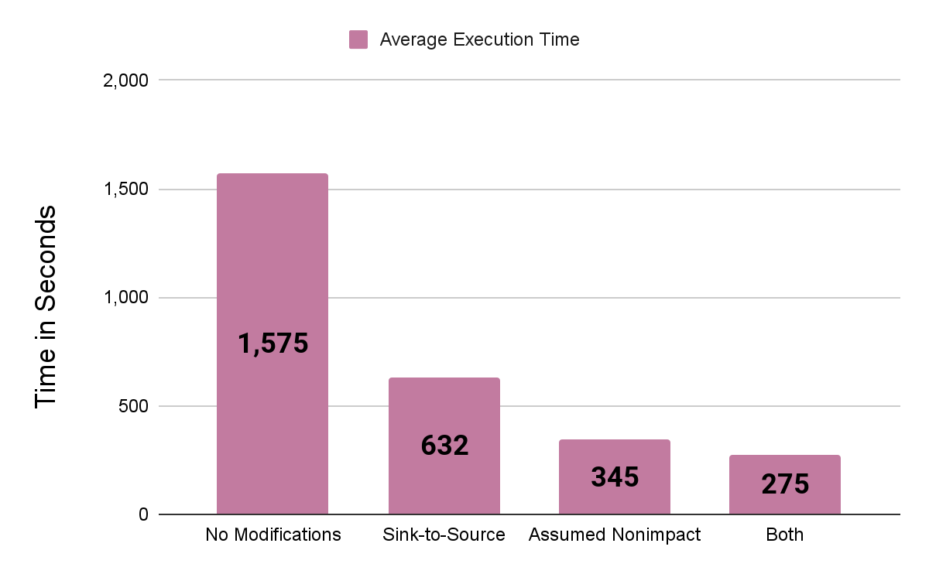
Mango—Time Ablation
Notes:
The bar on our left shows the initial MangoDFA with neither optimization taking 1500 seconds per binary. Where after applying both optimizations we lower our time to less than 300 seconds, a 5x increase in speed!

Slide 43
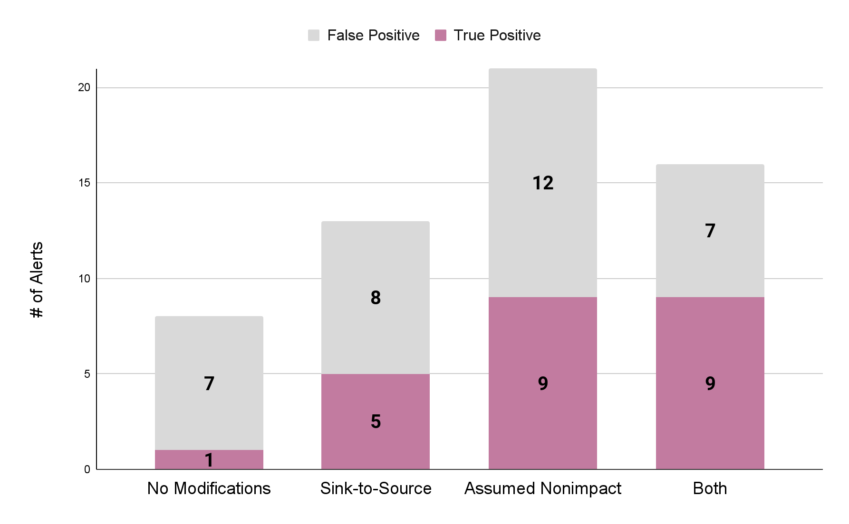
Mango—Alert Ablation
Notes:
This increase in speed also comes with more True Positives found. After applying both optimizations, we find 8 more true positives than through our original method.
We can further see that Source-to-Sink ultimately reduces the amount of False Positives found on the far right from it’s decrease in scope.

Slide 44
Mango—Efficacy
49 Firmware KARONTE Dataset
Notes:
Operation Mango was evaluated on the same dataset that prior works used, the KARONTE dataset of 49 firmware.

Slide 45
Mango—Efficacy
49 Firmware KARONTE Dataset
2,310 Alerts
Notes:
We generated 2310 Alerts over all of the firmware tested

Slide 46
Mango—Efficacy
49 Firmware KARONTE Dataset
2,310 Alerts
100 command injections
57 True Positives
57% TP Rate
Notes:
We randomly sampled and analyzed 100 command injections, resulting in 57 True positives

Slide 47
Mango—Efficacy
49 Firmware KARONTE Dataset
2,310 Alerts
100 command injections
57 True Positives
57% TP Rate
230 buffer overflows
109 True Positives
47% TP Rate
Notes:
We randomly sampled and analyzed 230 buffer overflows, and found 109 True Positives in those samples

Slide 48
Mango—Efficacy
49 Firmware KARONTE Dataset
2,310 Alerts
100 command injections
57 True Positives
57% TP Rate
230 buffer overflows
109 True Positives
47% TP Rate
Total: 52% TP Rate
Notes:
Overall, this gives our tool a 52% True Positive rate, or 1 in 2 alerts being vulnerabilities

Slide 49
Operation Mango vs SaTC
 | Analyzed Binaries | Alerts | Alerted Binaries | Runtime
SaTC
Operation Mango
Notes:
Now let’s compare Operation Mango against the Prior Work SaTC. This was done using the KARONTE dataset of 49 different firmware from 4 different vendors. We completed the experiments using a single core for each run.

Slide 50
Operation Mango vs SaTC
 | Analyzed Binaries | Alerts | Alerted Binaries | Runtime
SaTC | 131
Operation Mango | 3,599
Notes:
Analyzed 27.5x more binaries

Slide 51
Operation Mango vs SaTC
 | Analyzed Binaries | Alerts | Alerted Binaries | Runtime
SaTC | 131 | 144
Operation Mango | 3,599 | 2,310
Notes:
We generated 16x more alerts than prior work

Slide 52
Operation Mango vs SaTC
 | Analyzed Binaries | Alerts | Alerted Binaries | Runtime
SaTC | 131 | 144 | 52
Operation Mango | 3,599 | 2,310 | 174
Notes:
And found vulnerabilities in 3x more programs

Slide 53
Operation Mango vs SaTC
 | Analyzed Binaries | Alerts | Alerted Binaries | Runtime
SaTC | 131 | 144 | 52 | 860:58h
Operation Mango | 3,599 | 2,310 | 174 | 946:22h
Notes:
With only a 9% increase in time spent analyzing overall. But a 22x decrease in the average analysis time spent per binary.

Slide 54
Mango—Summary
Found bugs in 3x more binaries at 22x faster per binary
Notes:
It found bugs in 3x more binaries at 22x the speed per binary

Slide 55
Mango—Summary
Found bugs in 3x more binaries at 22x faster per binary
Manually verified 166 exploitable vulnerabilities
Notes:
We have manually verified 166 exploitable vulnerabilities.

Slide 56
Mango—Summary
Found bugs in 3x more binaries at 22x faster per binary
Manually verified 166 exploitable vulnerabilities
Operation Mango is open-sourced and available
Notes:
Operation Mango is open source on github and available.

Slide 57
Mango—Summary
Found bugs in 3x more binaries at 22x faster per binary
Manually verified 166 exploitable vulnerabilities
Operation Mango is open-sourced and available
Operation Mango is integrated in angr and will be maintained
Notes:
It is and will continue to be maintained on the angr platform

Slide 58
Thank You!
Operation Mango https://github.com/sefcom/operation-mango-public
Wil Gibbs | wilgibbs.com | wfgibbs@asu.edu | @cl4sm
Notes:
Thank you for coming to my talk!

